Slide 1
Word2vec v/s Glove
word2vec is based on one of two flavours: The continuous bag of words model (CBOW) and the skip-gram model.
CBOW is a neural network that is trained to predict which word fits in a gap in a sentence.
The order of the words is not important.
The embedding layer of the neural network is used to represent words in general.
On the other hand, the skip-gram model works in the other way round. Given a middle word it outputs a probability for each word in the vocabulary.

Slide 2
Word2vec v/s Glove
GloVe takes a different approach.
The embeddings are optimized directly so that the dot product of two word vectors equals the log of the number of times the two words will occur near each other (within 5 words for example).
For example if "dog" and "cat" occur near each other 10 times in a corpus, then vec(dog) dot vec(cat) = log(10).
This forces the vectors to somehow encode the frequency distribution of which words occur near them.

Slide 3
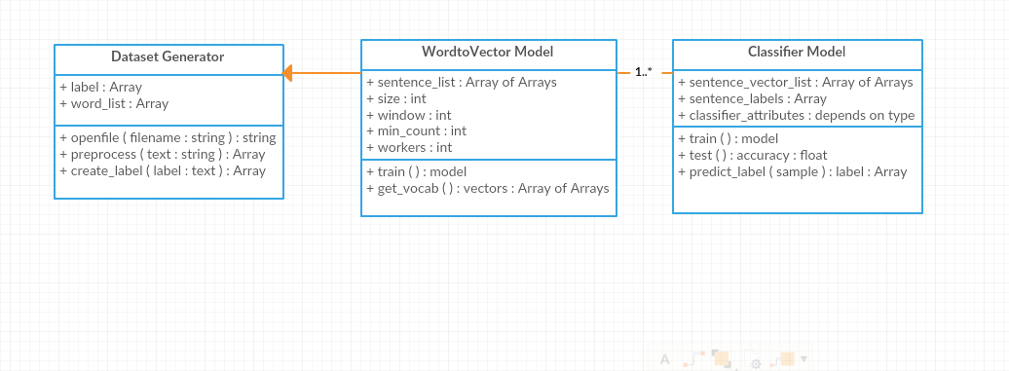
Class Diagram

